Slide 1


TOP Opportunities
  Supported Employment Program
Green Keepers
  Social Enterprise Business
TOPOP Participants

Slide 2
What is TOP Opportunities (TOPOP)?
TOPOP is a vocational rehabilitation and supported employment program for adults who want to rebuild their lives through work and education.
We pair each of our participants with an Employment Specialist, who helps them in achieving their personal employment goals, no matter where they start or want to end up.
TOPOP Participant

Slide 3
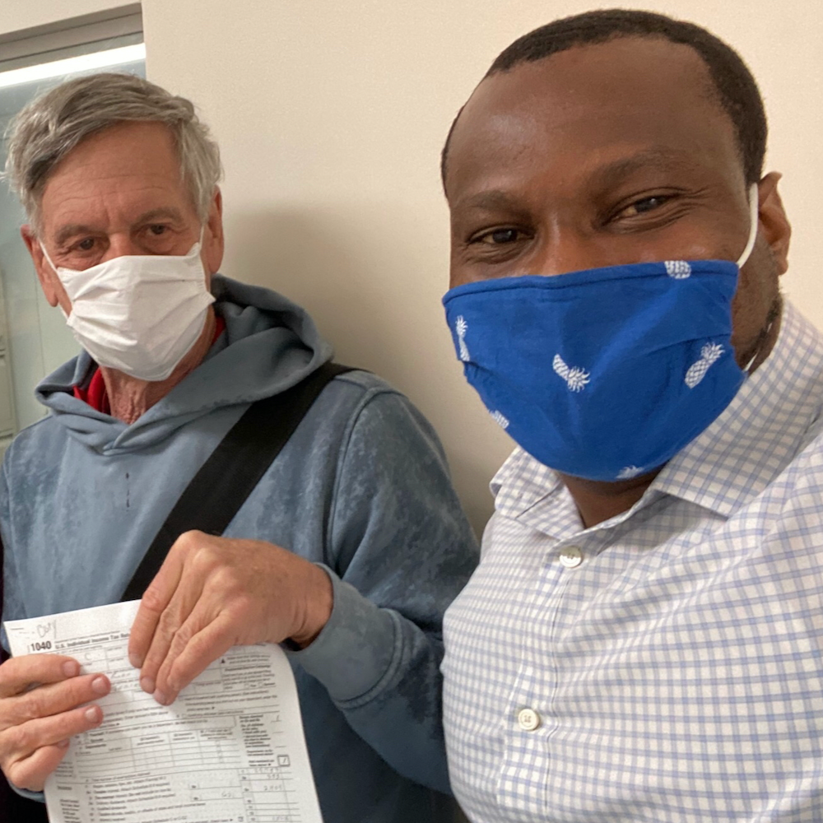
TOPOP Vocational Services
We offer comprehensive services such as:
  Vocational and Career Counseling
  One-on-one assistance with job searches, resume writing, and interview preparation
  Job leads and referrals
  Career Exploration and Work Skills Assessments
  Skills Training Groups (money management, computer skills, interviewing and more)
  Job retention services (job coaching, employer assistance)
  Benefits Counseling
Bobby Idowu, Program Manager
Sheldon Barasch, Supervising Tax Preparer from our partner, Community Tax Aid

Slide 4
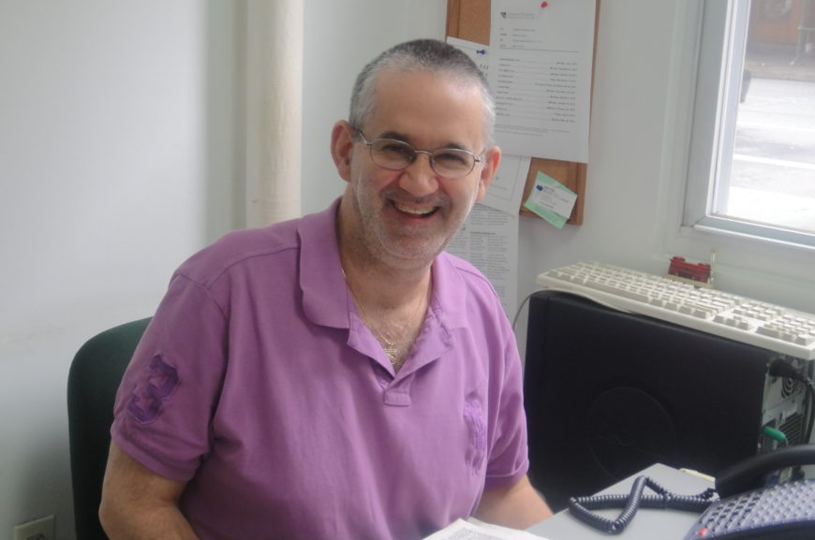
Adapting to the Pandemic
All of our vocational services are now offered both in-person AND virtually.
Our Employment Specialists individually train each participant on teleconferencing, email, and remote job seeking.
This way, all participants are ready for the new normal.
TOPOP Participant

Slide 5
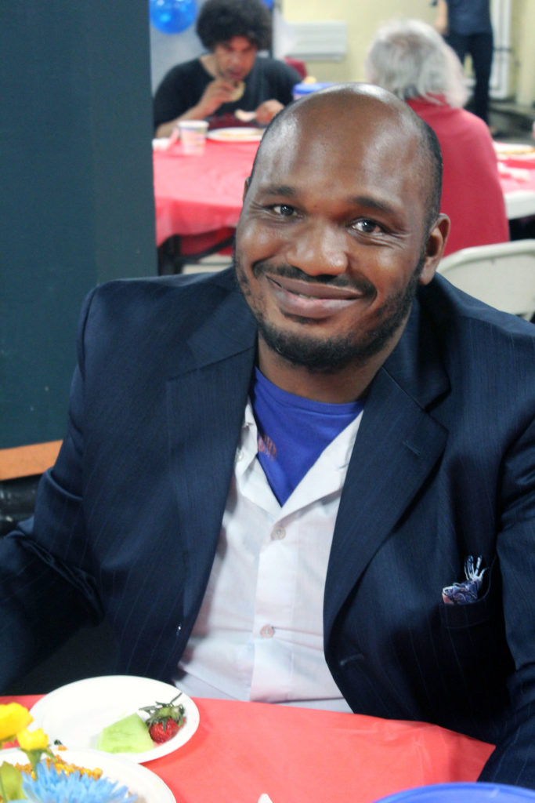



















Where do our job seekers go?
TOPOP Participant

Slide 6
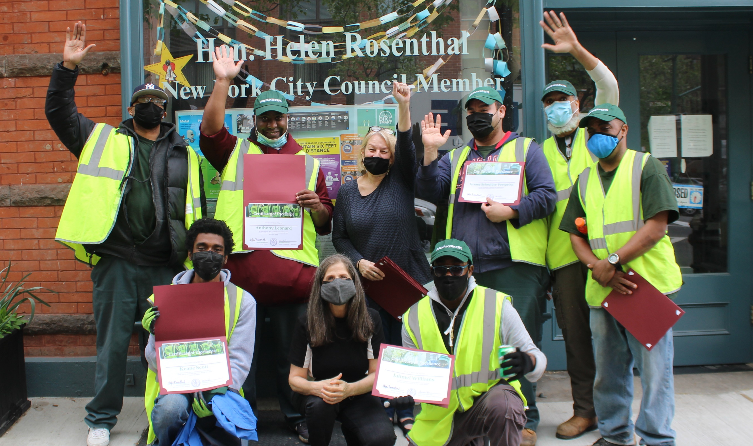
We understand that adequate job training and experience is hard to come by…
Thus, we also offer placement into our own successful business, the Green Keepers.
Council Member Helen Rosenthal & The Green Keepers

Slide 7
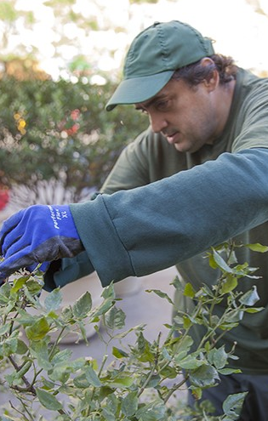
Who are the Green Keepers?
Established in 1995, Green Keepers is Goddard Riverside’s small business that works throughout the New York City area for public, commercial and residential properties.
Green Keepers perform horticulture services such as garden preparation, planting, and watering.
Green Keepers provides general street sanitation services and indoor maintenance.
Green Keepers is further supported by the TOPOP Program.
Green Keepers Sanitation
Green Keepers Horticulture

Slide 8
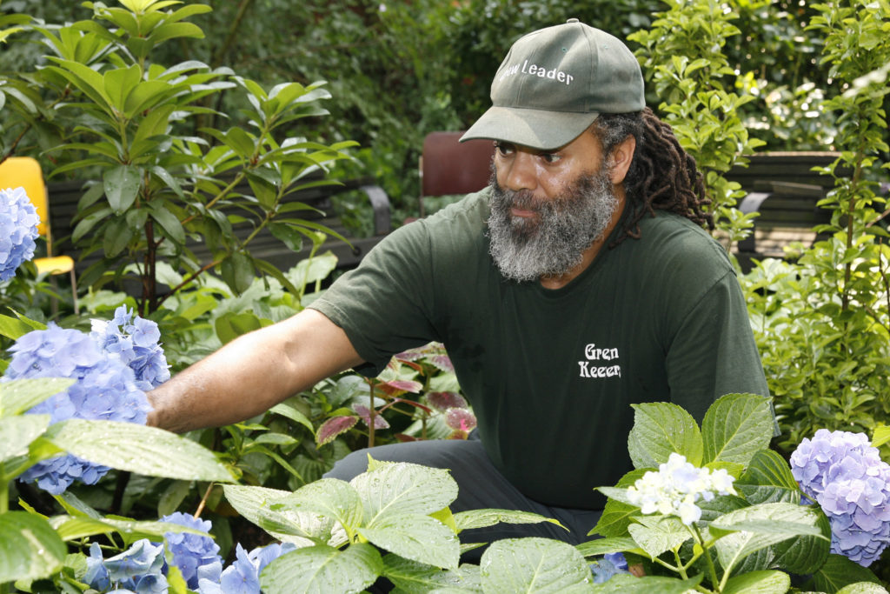
What do the Green Keepers offer?
We professionally train and hire interested job seekers as Groundskeepers in sanitation, maintenance, and horticulture.
Each participant is paired with a Specialist to keep their resumes updated, job seeking skills sharp, and maintain long term employment.
We help build participants up to working a minimum of 15 hours per week!
Project Supervisor, Leslie Ware

Slide 9
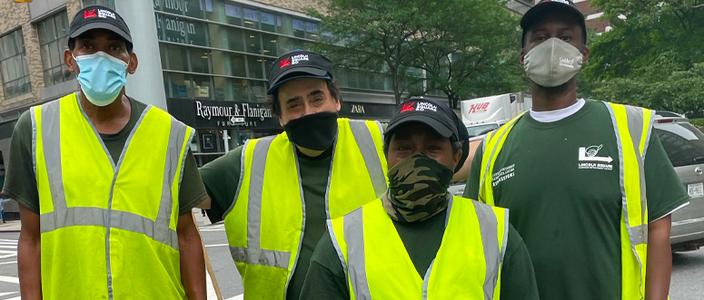
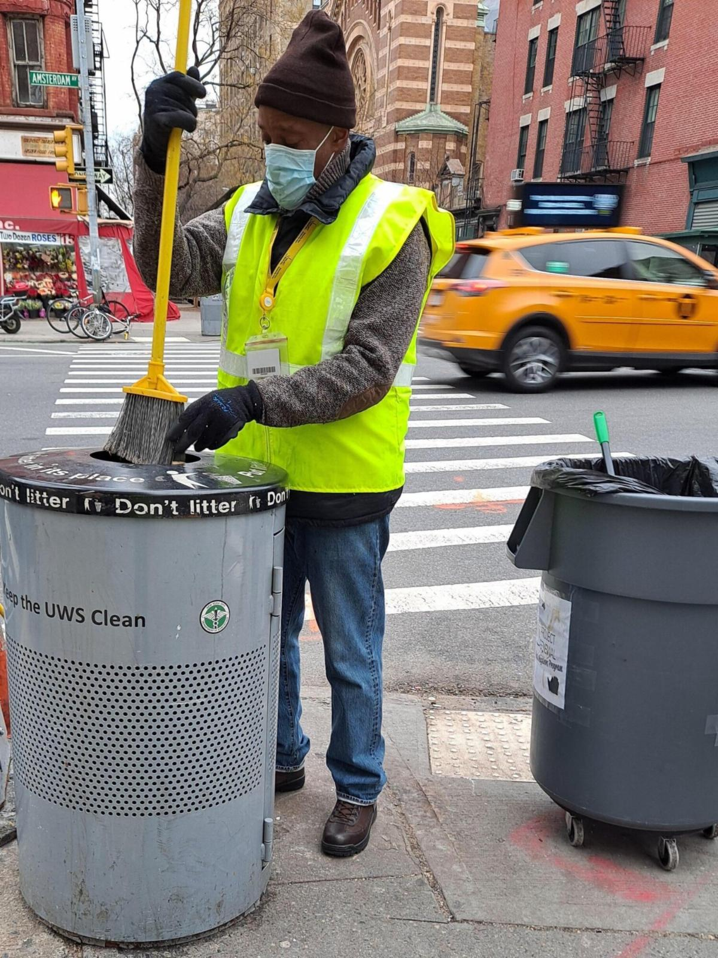
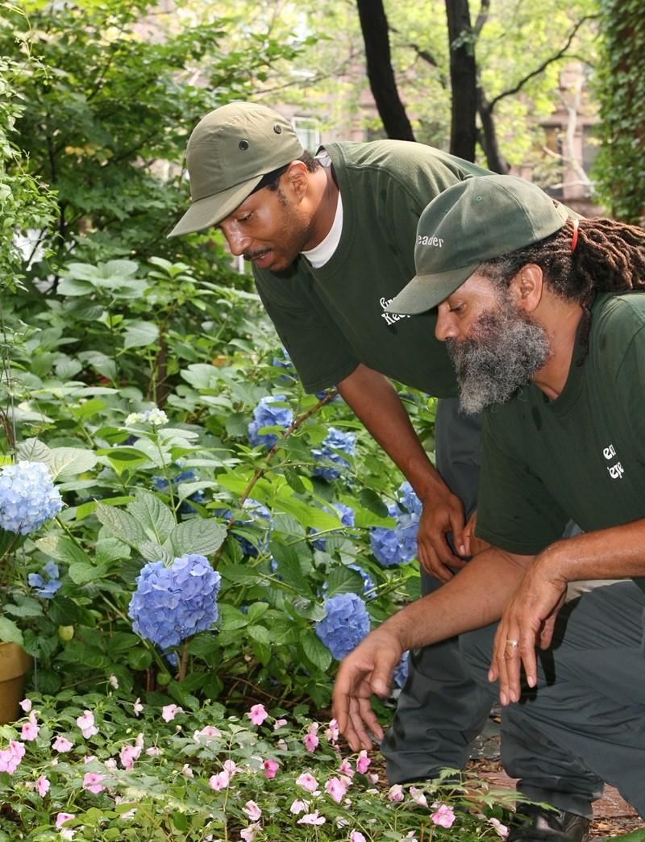
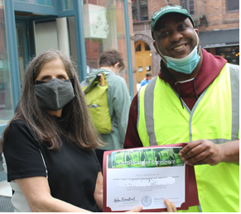
Green Keepers
Words from Our Partners
“The group has performed wonderfully, and it has been very satisfying for us to work with the team.” - Bob Herrmann, President of Broadway Malls Association
“We are proud of our long-term partnership with Goddard and are grateful for our Greenkeepers’ dedication to the Lincoln Square BID and the neighborhood.” – Lincoln Square BID
“We are extremely appreciative of the Green Keepers contribution…” - Debra Sheintoch, Director of Volunteers of Riverside Park Conservancy
Being Awarded Certificate of Excellence

Slide 10
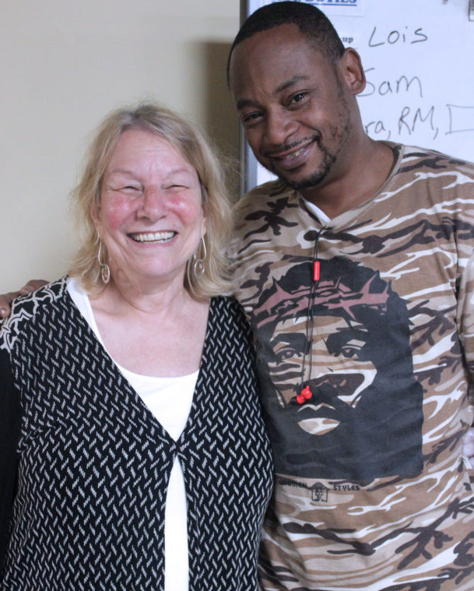
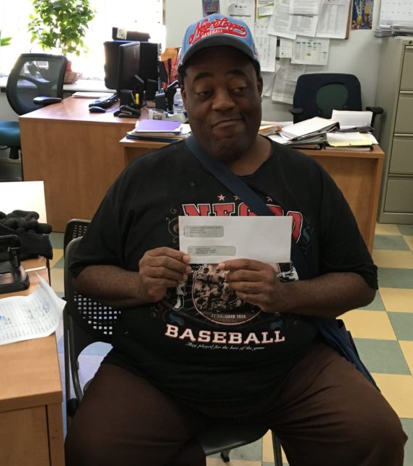
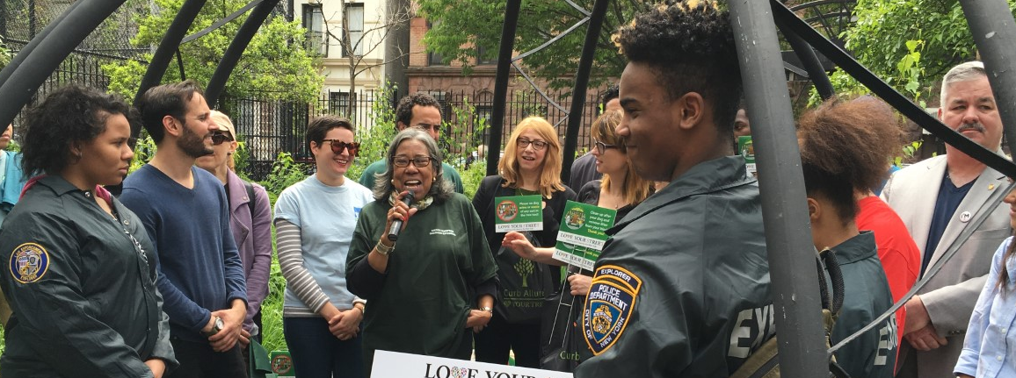
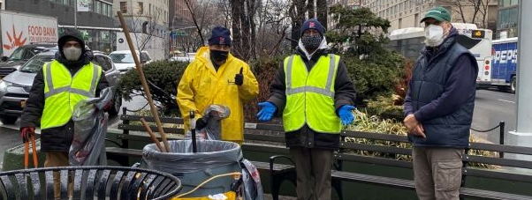
Who’s Eligible?
Applicants must:
  Have a primary diagnosis of serious and persistent Mental Illness.
  Have case management services.
  Have original employment eligibility documents.
  (Ex: State ID, SS Card, Passport)
Director, Debby Kaplan with
Bernard Clark, Senior Center Food Services
Green Keepers at “Love Your Street” Community Event

Slide 11


How to Apply
Obtain Employment IDs
(State ID & Social Security Card)
Complete Assessments
(Physical, Psychiatric, & Psychosocial)
Submit Referral Packet
(Fax or Encrypted Email)
1
2
3
If you have trouble getting some of the documents...
Let us know!
www.goddard.org/programs/behavioral-health/topop/

Slide 12
Questions?
Office: (646) 505-1088
Email: topop@goddard.org
Fax: (646) 505-1096
www.goddard.org/programs/behavioral-health/topop/
Let’s get back to work!

